Slide 1
F.O and Subs Accrual Policy Effective March 31st, 2021

Slide 2
Purpose
The purpose of this policy is to expedite the processing of field office, subrecipient and sub-contractor’s monthly expense reports.

Slide 3
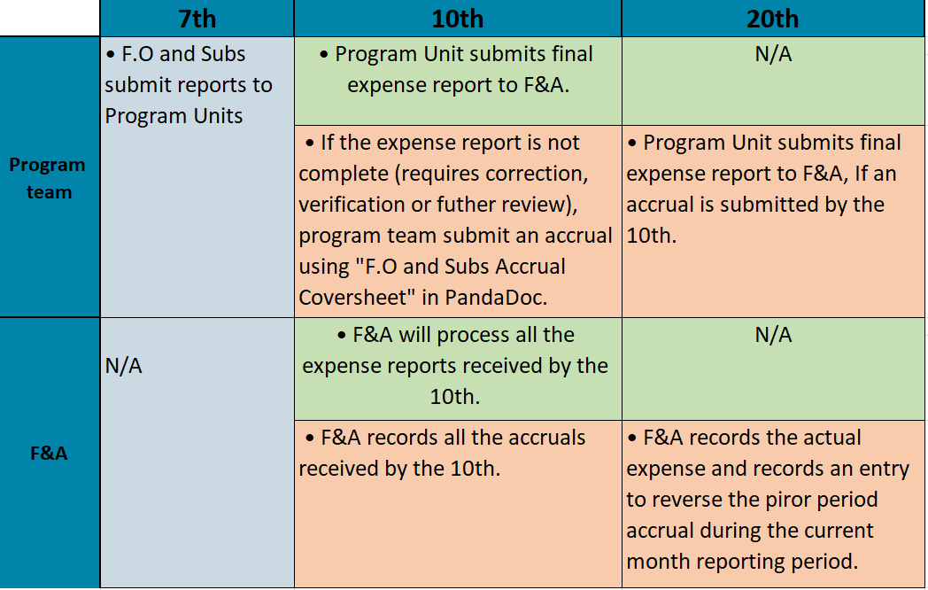
Important Dates

Slide 4
Reminders
Please try to submit actual reports by the 10^{th.}
It is very important that the accrual amount is as accurate as possible.
Note that you do NOT need to submit an accrual for December report, as F&A will process ONLY actual reports for December.

